Slide 1
The juridical status of Constantinople between Constantine and Julian
International Seminar "Issues of Roman Law and Roman Maritime Law"
27 March 2026
An accompanying event to the 14th National Maritime Law Conference, Gdańsk, March 26, 2026
Benet Salway,
History Department, University College London (r.salway@ucl.ac.uk)

Slide 2
The juridical status of Constantinople between Constantine and Julian
The significance of Constantine’s policies towards the traditional senatorial aristocracy of the city of Rome and of the establishment of his new eponymous city on the Bosphorus continue to be the subject of considerable debate.
This paper continues on from those that I delivered at the Colloquia Ceranea II, Łódź, 24 April 2020 (on the city of Rome under Constantine) and at the International Congress of Byzantine Studies, Venice, 23 August 2022 (on the development of the senate of Constantinople)

Slide 3
By the 370s the status of Constantinople certainly resembled that of contemporary Rome: a city hosting an imperial senate, standing outside the provincial organisation, governed by a prefect who enjoyed an appellate jurisdiction extending over nearby provinces, and itself enjoying the privilege of the immunity from direct taxation on land and persons.

Slide 4
Historiographical problems
Ancient contemporary traditions are polarised because of controversial religious position of Constantine.
Christian sources, going back to Eusebius in first half of 4th century, exaggerate significance and Christian character of Constantinople.
Pagan sources, going back to Eunapius in second half of 4th century, downplay importance of Constantinople.

Slide 5
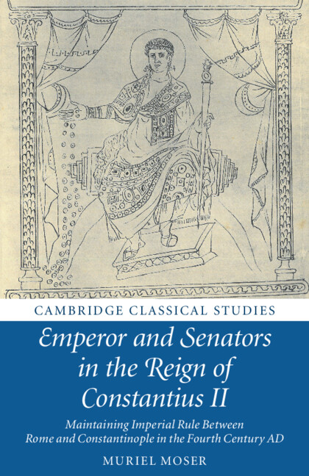
Revisionist work by scholars such as Muriel Moser (Emperor and Senators in the Age of Constantius 2018) has undermined the traditional narrative that ascribed to Constantine himself an intention to make Constantinople a New Rome.

Slide 6

However, John Matthews (From Byzantium to Constantinople: An Urban History, 2024) has voiced renewed support for aspects of the Byzantine tradition.

Slide 7
This paper re-examines the evidence for the juridical status of Constantinople between the 320s and 360s to shed light on the stages and motivations behind the development of the special status of Constantine’s new city.

Slide 8
Against e.g. André Chastagnol, Peter Heather, John Matthews, and following Gilbert Dagron and recently M. Moser (Emperor and Senators in the Age of Constantius II, 2018), I argue:
that there is little evidence that, at its foundation, Constantinople was intended as an institutional rival to the traditional position of the older Rome.
That its special status as an altera Roma develops gradually after the death of Constantine

Slide 9
A careful focus on the status of the institutions and administrators of Constantinople helps to reveal the steps by which the city only gradually acquired a special position after Constantine’s death, as an increasingly important asset to the regime of Constantius II.

Slide 10
Relationship of courtiers to senators
After defeat of Licinius (Autumn AD 324), at the same time as Constantine refounds Byzantium as Constantinopolis:
Grants senatorial title (uir clarissimus) to officials upon entering highest posts of equestrian career (e.g. praetorian prefecture) and to circle of imperial companions (comites) not already senators
Grants equestrian honours to many of municipal status in East (Eusebius, VC 4.2):

Slide 11
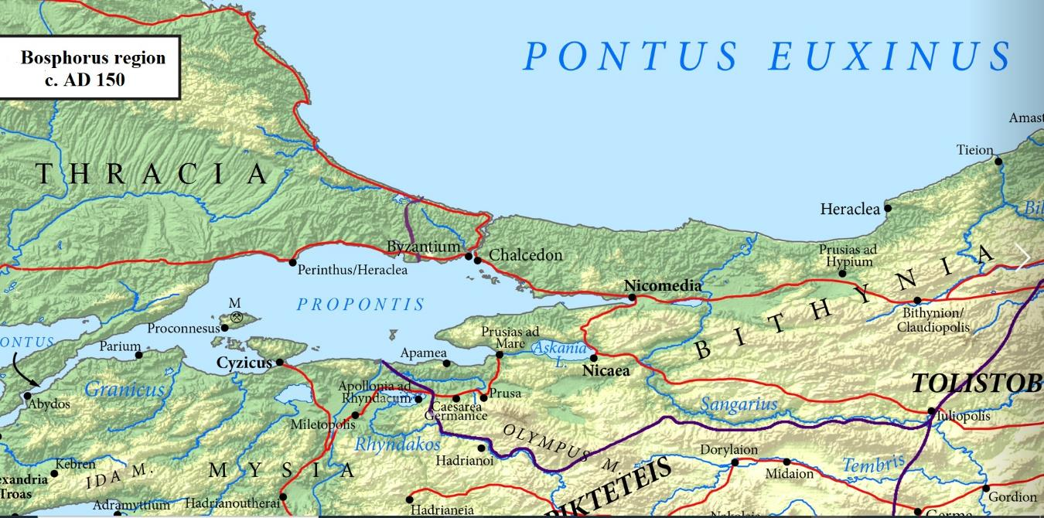
The status of Byzantium before 324
From creation of Thrace under Claudius to civil war of 193-197, Byzantium was a free Greek polis, but under supervision of governor of Pontus-Bithynia, with centurio regionarius stationed there, as we know from the letters of Pliny the Younger (Ep. X.77).

Slide 12
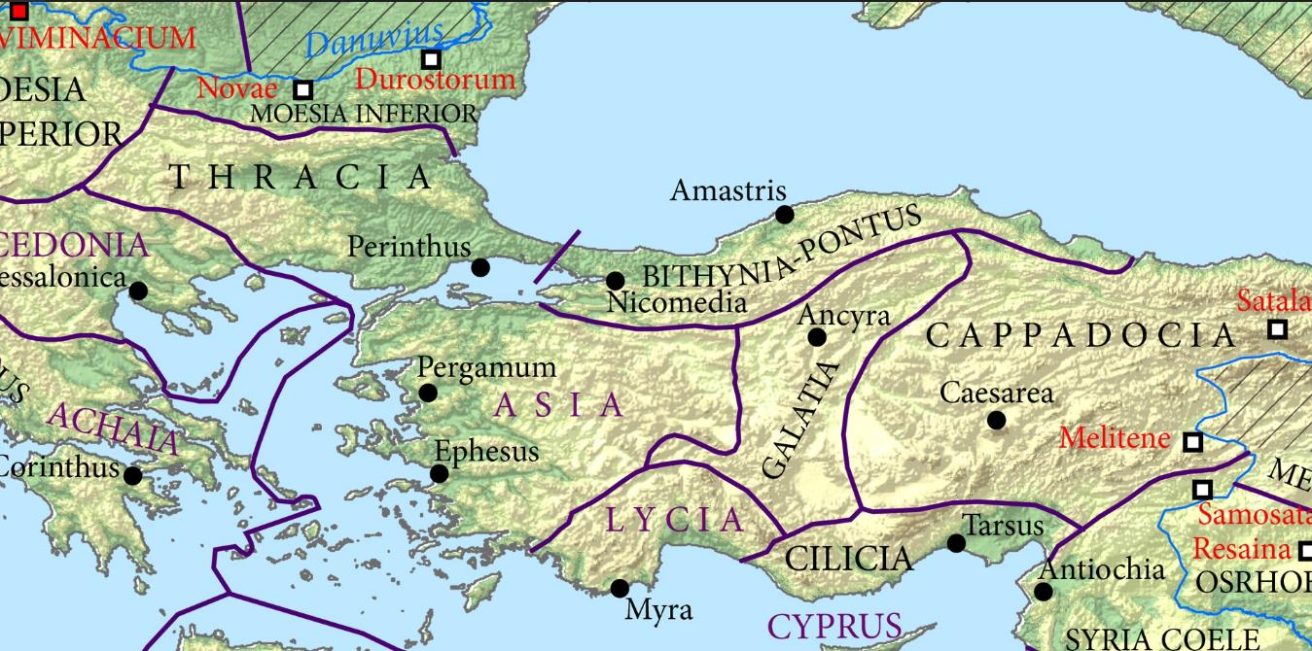
The status of Byzantium before 324
Byzantium was punished for loyalty to the cause of Pescennius Niger, supposedly reduced to status of a κώμη of Perinthus, but restored to civic status as Greek polis or, even (so Matthews), raised to a Roman colonia by Caracalla.

Slide 13
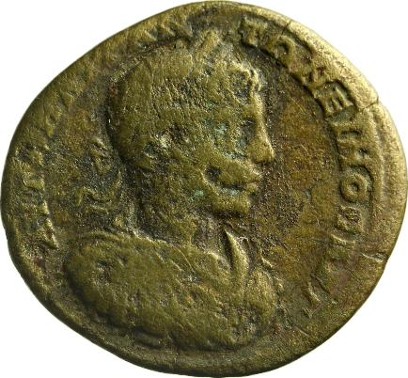
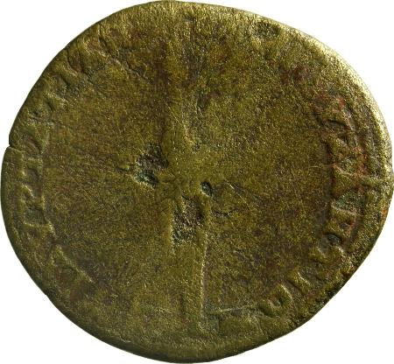
But the coinage of Byzantium shows no indication of change (cf. coinage of Tyrus colonia Septimia Metropolis – RPC V.3 ID 87099, 69677)
RPC Volume: VI №: 874 (temporary)
Reign: Elagabalus Persons: Elagabalus (Augustus) Magistrate: Marcus Aurelius Tatianos (heros)
City: Byzantium Region: Thrace Province: Thrace
Denomination: Æ (30 mm) Average weight: 14.30 g.
Obverse: ΑΥΤ Κ Μ ΑΥΡ ΑΝΤΩΝΕΙΝΟϹ ΑΥΓ; laureate, draped and cuirassed bust of Elagabalus, right, with aegis, seen from front
Reverse: ΕΠΙ ΑΥΡ ΤΑΤΙΑΝΟΥ ΗΡ ΒΥΖΑΝΤΙΩΝ; lighted torch
Reference: Schönert-Geiss, Byzantion 1657 Specimens: 3

Slide 14
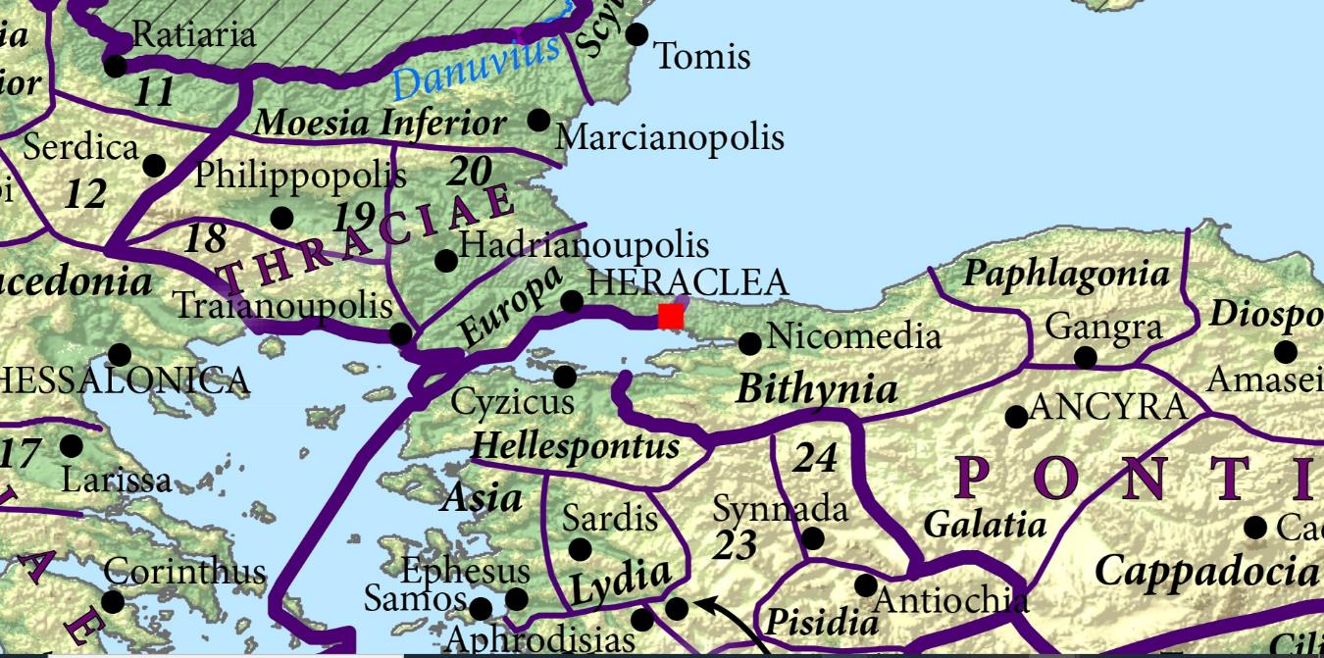
The status of Byzantium before 324
During later 3rd century senatorial governors of surrounding provinces replaced by equestrian praesides (e.g. I.Perinthos-Herakleia, 14-17), by which time Byzantium transferred to the province of Europa with its chief city at Perinthus-Heraclea.

Slide 15

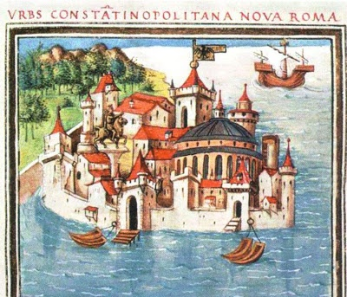
330: triumphator over Goths; inauguration of Constantinopolis (11 May)
Fortunae reduci ob deuictos Gothos

Slide 16
Series of medium bronze medallions struck for inauguration of Constantinople
A. Type of GLORIA EXERCITVS, struck for Constantine II.
B. VRBS ROMA
C. CONSTANTINOPOLIS

Slide 17
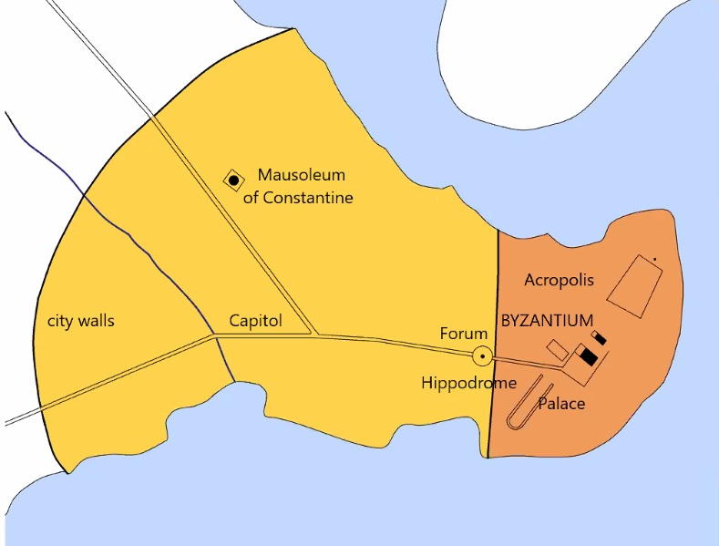
Constantinople under Constantine
Hypothetical:
in 324/330 Constantinople refounded as colonia Romana (Moser)
and/or as existing colonia (Matthews) granted the Ius Italicum.

Slide 18
The status of Constantinople under Constantine
Key texts for proponents of the special status of Constantinople from the outset – i.e. imperial ‘capital’, standing outside formula prouinciae of Europa - (e.g. Chastagnol, Heather, Matthews) are later 4th-century Origo Constantini and CTh 3.32.2 (c. 330-337)

Slide 19
Origo Constantini (Anonymus Valesianus, pars prior), 6.30
He (Constantine) established there a senate of the second order and called its members ‘clari’: ibi senatum constituit secundi ordinis, claros uocauit.
Moser (2018), 57-63, argues that this enigmatic account is compatible with a colonia splendissima Constantinopolis, with uiri splendidi/splendidissimi curiales.

Slide 20
Libanius, Or. 42 (in defence of Thalassius c. AD 390)
Mentions Ablabius and Tychamenes, under Constantine, as precedents for disreputable senators in Constantinople.
But these are clarissimi in Constantinople not of Constantinople.

Slide 21
Constantinianus praetor at C’ple? (CTh 3.32.2 c. 330-337)
Yes, acc. to Chastagnol, appealing to CTh 6.4.5 of 9 Sept. 340 (issued ad senatum from Antioch), which does attest to a praetor in Constantinople.
But, as comparison with overlapping fragments in CJ (5.71.18 + 7.62.17) demonstrates, that acephalous and undated CTh 3.32.2 relates to Rome not Constantinople (see Moser 2018, 69-72)

Slide 22
The status of Constantinople under Constantine
Certainly there is a change of status for the governor of the region in the wake of the defeat of Licinius …

Slide 23
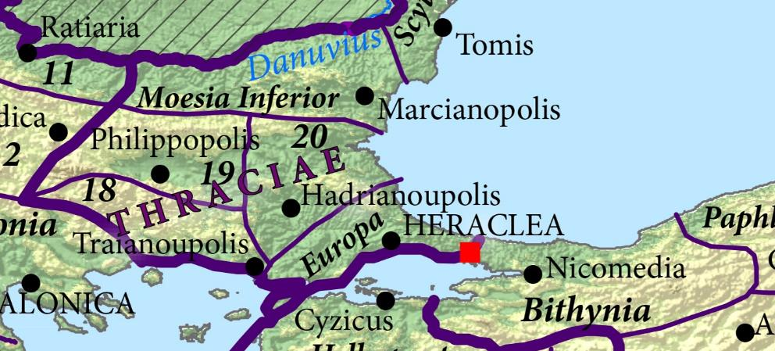
ILS 1240 Valerius Proculus, consularis prouinciae Europae et Thraciae (after 324)

Slide 24
The status of Constantinople
Certainly by AD 334 Constantinople received annona ciuica (CTh 13.5.7)
By 340 it has magistrates termed in Latin praetores (CTh 6.4.5 of 9 Sept. 340, issued ad senatum from Antioch)
By 342 a governor, titled proconsul, is attested (Libanius, Or. I.44-45)
by 351/352 had an assembly populated by uiri clarissimi

Slide 25
The status of Constantinople
from 359 a civic administration headed by a praefectus urbi;
and by 370/372 (CTh 14.13.1):
Italici iuris auxilium arbitra aequitate renouamus. Concessi igitur gratia beneficii publicis actibus intimetur et incisa tabulis debite sollemnitate permaneat. Dat. prid. non. Aug. Hierapoli, Valentiniano et Valente AA. conss.
‘With judicial equity we renew the assistance of the Italian right. Therefore, the benefit of this grant as conceded shall be registered in the public records and, engraved upon tablets with due solemnity, shall remain forever.’

Slide 26
The status of Constantinople
But was it set on this trajectory of aemulatio Romae already by Constantine?
How do we understand the significance of the proconsul?

Slide 27
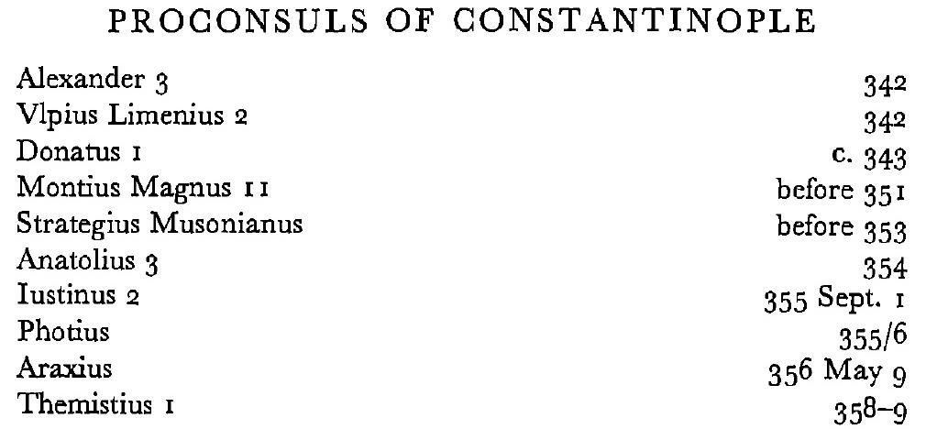
Proconsul of C’ple as forerunner of praefectus urbis Constantinopolitanae?
PLRE 1, Fasti, p. 1056
None of the supposed office-holders attested between AD 342 (PLRE I Alexander 3) and AD 358 (Themistius 1) is described as proconsul urbis/ἀνθύπατος τῆς πόλεως (vel sim.).

Slide 28
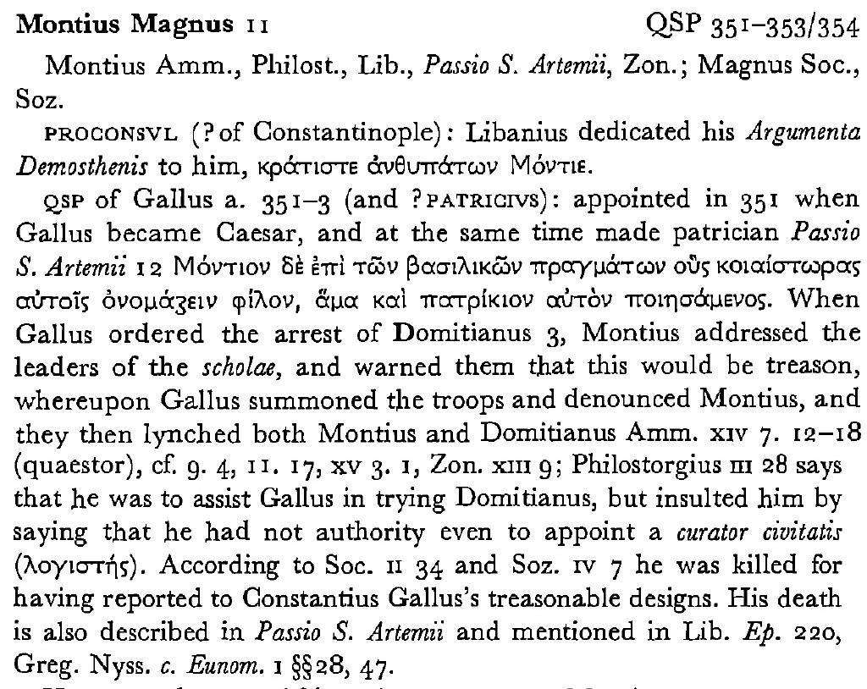
Before 351: PLRE 1, Magnus 11

Slide 29
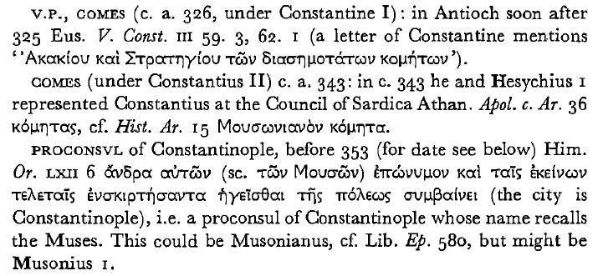
Before AD 353: PLRE 1, Musonianus

Slide 30
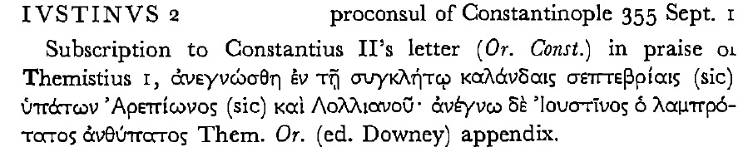
01.09.355: PLRE 1, Iustinus 2

Slide 31
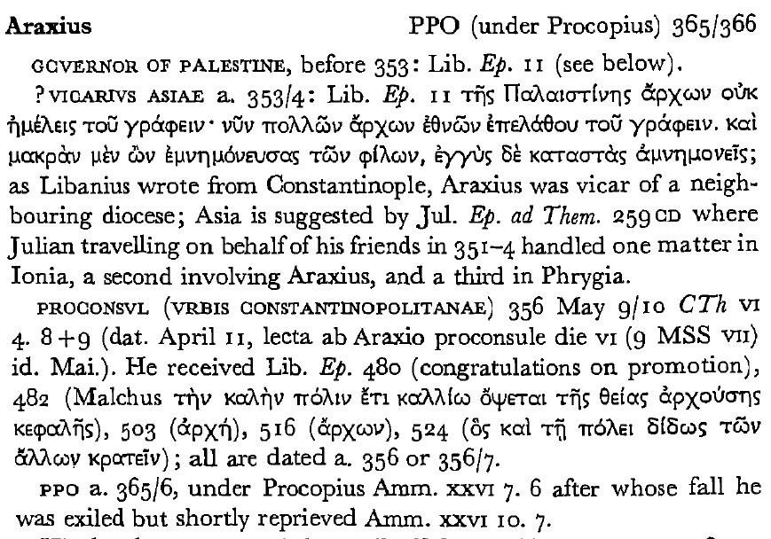
AD 356-357: PLRE 1, Araxius

Slide 32
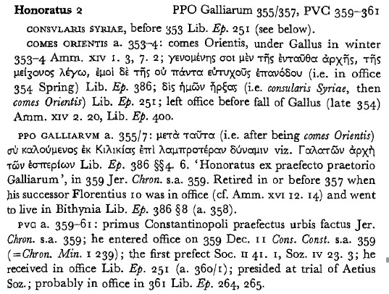
AD 359: PLRE 1, Honoratus 2

Slide 33
Proconsul of C’ple as forerunner of praefectus urbis C’politanae?
Much easier to understand the post of proconsul as proconsul prouinciae Europae, often present in Constantinople as capital of the province until 359, when Constantinople separated from prouincia Europa and capital of the province reverted to Heraclea-Perinthus.

Slide 34
A plausible timeline?
AD 324: Refoundation of Byzantium as (Roman colonia?) of Constantinopolis; replacement of praesides of Europa and Thrace by consularis Europae et Thraciae
AD 330: Inauguration (according to Moser 2018) of splendidissima colonia, with curia of uiri splendidi

Slide 35
A plausible timeline?
<340: death of Constantinus Iunior Aug.>
governor of Europa upgraded to proconsul (Thrace reverts to equestrian praesides: ILS 8944); chief magistrates of C’ple to praetores.
<usurpation of Magnentius 350-353>
after AD 351/2: recruitment of new curia of uiri clarissimi begins (e.g. Themistius)

Slide 36
A plausible timeline?
<357: visit of Constantius II to Rome>
AD 359: Honoratus first Praefectus Vrbis Constantinopolitanae
<362: grant of ius Italicum to his patria by Julian?>
AD 370/372: confirmation of privilege of ius Italicum by Valens (CTh 14.13.1)

Slide 37
Final observations
Aside from the annona, none of the special (Rome-like) features of Constantinople can be securely dated before the death of Constantine.
The promotion of Constantinople most plausibly arises the exigencies of political rivalry between Constantius II and Constans in the 340s and then Magnentius in the early 350s.
The timing of the grant of the ius Italicum remains obscure.

Slide 38
Thank you for your attention. Dziękuję za uwagę
International Seminar "Issues of Roman Law and Roman Maritime Law"
27 March 2026
An accompanying event to the 14th National Maritime Law Conference, Gdańsk, March 26, 2026
Benet Salway,
History Department, University College London (r.salway@ucl.ac.uk)

