Slide 1
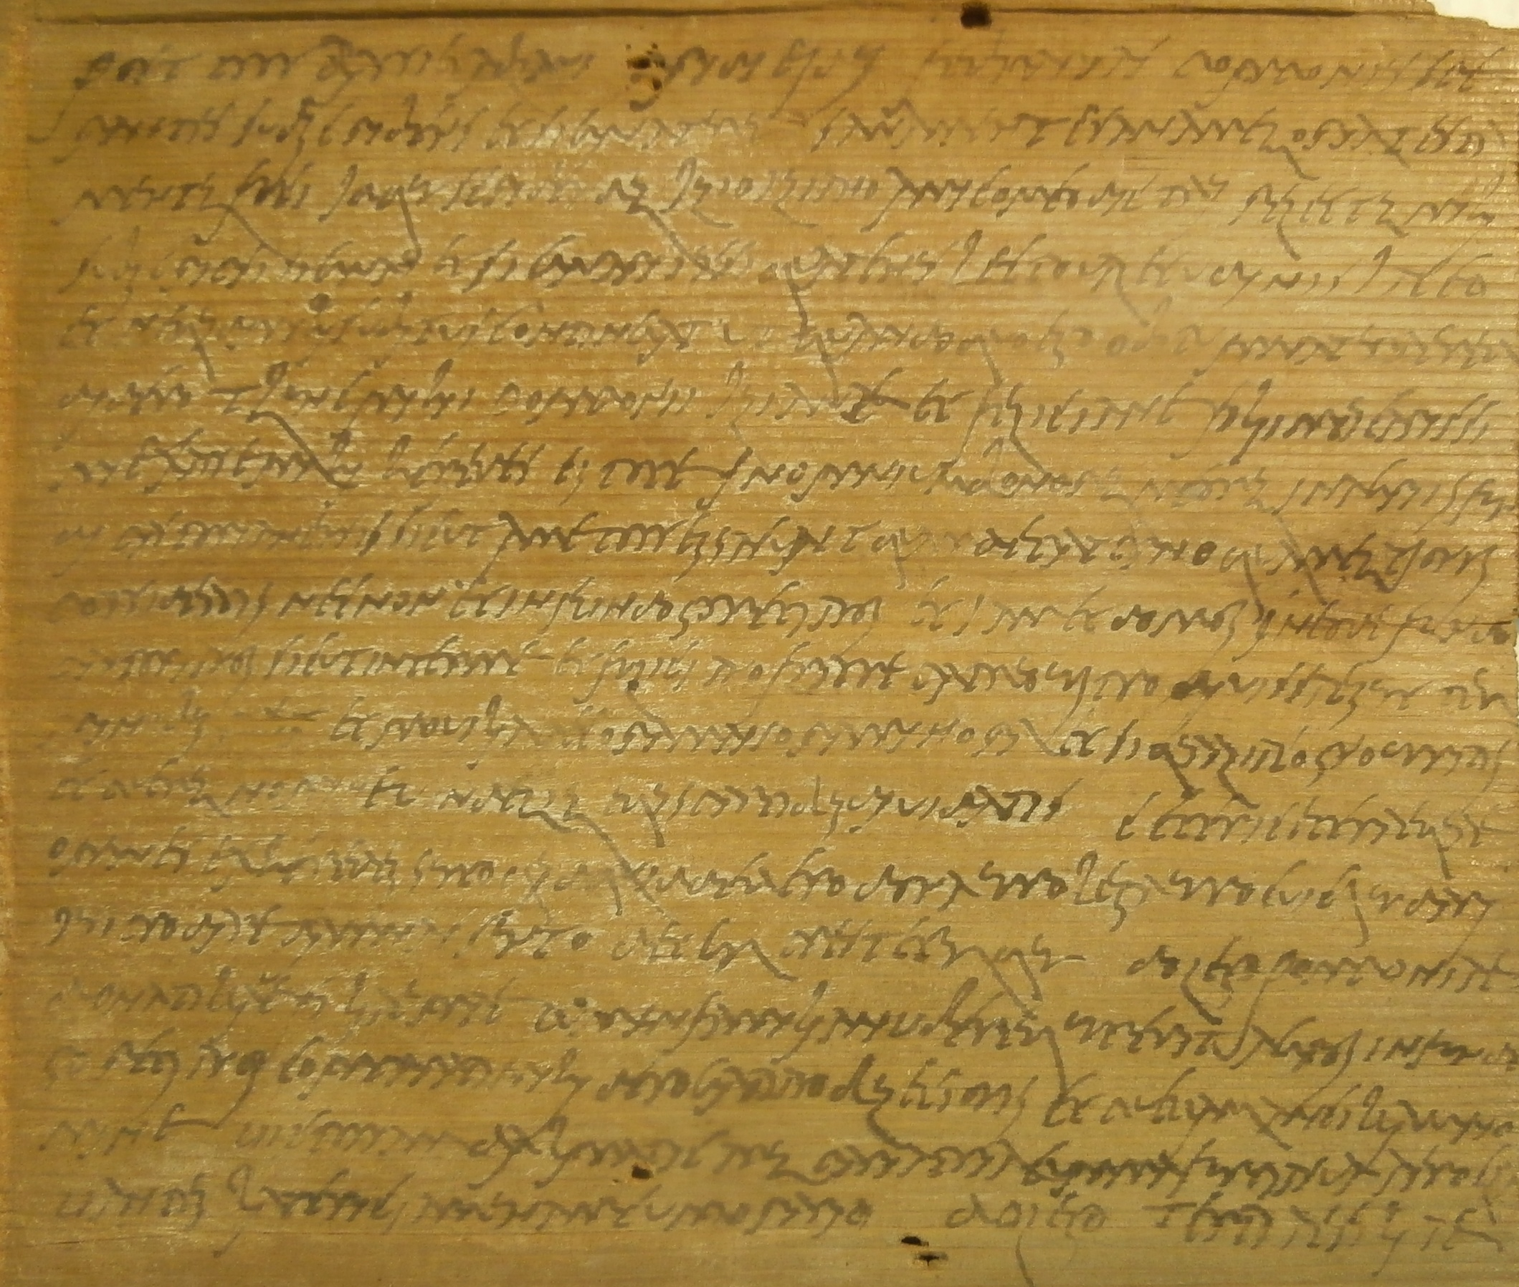
Testamentary practice in the 3rd and 4th century: New documents
Peter Rothenhöfer
Peter Rothenhoefer

Slide 2


NOWAK 2015: Strobel 2014:

Slide 3
General problem:
Geographical:
Lack of documentary sources,
especially outside of Egypt and from
provinces in the Western part
of the Roman Empire
Nowak:
- 45 „Local wills from the Roman period“ [Egypt]
- 34 „Roman wills“ [33 Egypt, 1 Britain]
- many in a very fragmentary state of preservation

Slide 4
General problem:
Chronological:
Lack of documentary sources,
especially of the later 3rd
and 4th century
5 „Late Roman wills“ (4th century)
[all from Egypt except the one
of Gregory of Nazianzus]
[or 7 for the 4th and 5th c.]

Slide 5
Characteristics of the Roman testamentum per aes et libram (or mancipatory will), i.a.
highly formalized to be valid
includes the mancipatio nummo uno, a symbolic act transferring ownership of the property of the testator into the control of a fictive buyer for execution
needs to be singed by witnesses (5 + familiae emptor + libripens) and the tablets fixed together in a special way (cf. SC Neronianum)
- was this act performed or was it only reduced to a mere formula?
can we observe changes in the testamentary practice (e.g. use of formula, number of witnesses etc.)

Slide 6
Questions, e.g.:
How widespread was the use of Roman law in the provinces?
Can we observe changes in the testamentary practice (e.g. in the use of formula, number of witnesses etc.)?
More specific:
Did the symbolic act of the mancipatio loose significance?
Who were the writers (notarii?)
Where was the will kept?
What was the role of the witnesses/signatores?
How was the testament opened?

Slide 7
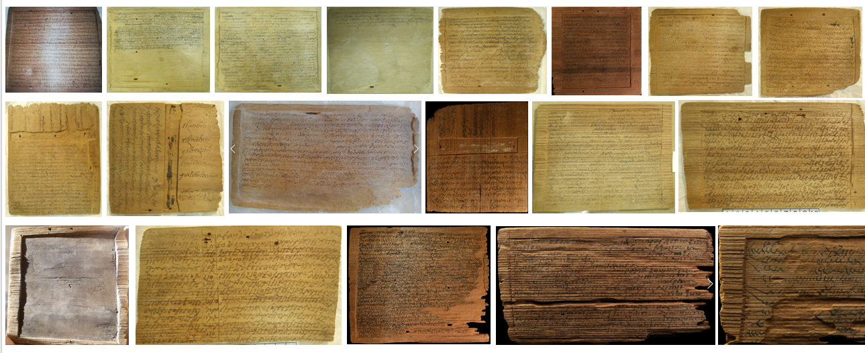
New documentary evidence allows new insights:
More than 50 tablets with legal documents from the 3rd-4th century

Slide 8
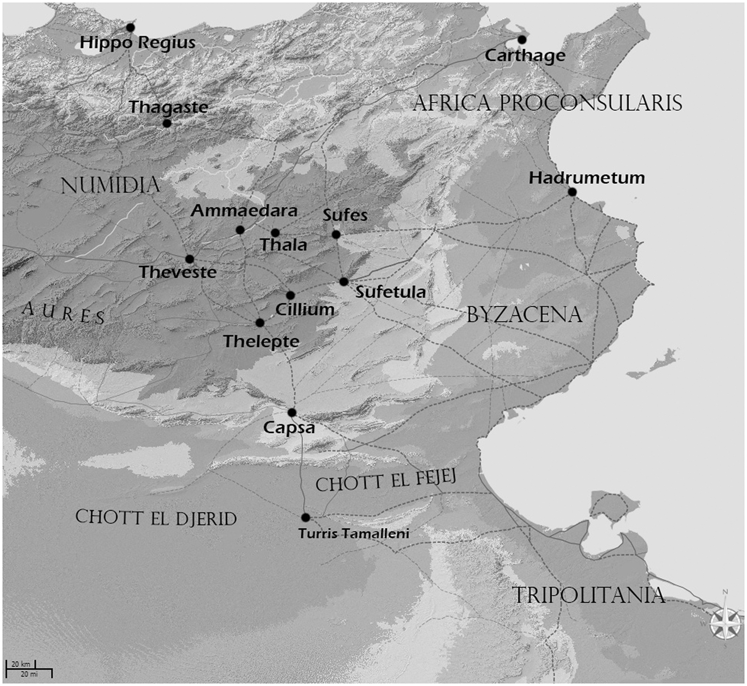
Unknown findspot
within the provincia
Byzacena,
Found before 1950
in the border
region between Numidia
and Byzacena

Slide 9
Presumably not from
an archive,
but from an ancient
complex of tablets
collected for reuse

Slide 10
wills/testamenta
contracts of sale
auctoritates agrorum, auctoritates auctionis
exempla rerum descriptionum
exemplum sententiae (tutorship)
tabellae/pacta dotis
documents regarding a compensation after eviction
testationes

Slide 11
Testament/Testator | Date (A.D.) | Tabula I | Tabula II | Tabula III
Iulius Dontiquus (exemplum) | 281 |  |  | X
Valerius Aemilius Vernucius | 301 |  |  | X
Pomponius Sperantius | 332 | X
Iulius Pompeianus | 340 | X |  | X
anonymous testator (father of Iulius Primus) | 1st half 4th century |  | X | X
anonymous testator | about mid 4th century |  |  | X
anonymous testator | 366 | X
Pomponius Maximus | 371 | X |  | X
anonymous testator (husband of Iulia Fortunata) | 1st half 4th century |  | X
Iulia Donatilla | mid 4th century |  |  | X
Macrinius Magarius | 4th century |  |  | X
protocol of the opening of the will of Aelius Urbanus | 328 | X

Slide 12
Some formal observations:
- Latin text on inked wooden tablets/tabulae
/testamentum atramento scripto
- reused tablets
- text written in Roman cursive script
- no wax tablets/tabulae ceratae used for testaments
- holes and sulcus (not on copies/exempla)

Slide 13
Situation in which the will was made and persons who were present:
### no public officials involved!
Private environment: testator, writer (often called amicus), emptor familiae, libripens, at least 5 witnesses

Slide 14
Formal requirements of a mancipatory will: the dating clause
Testamentum Dontiqui (April 9th, 281) (beginning of the will lost!): at the end of the will, before the mancipatory clause
(11-12) .... Probo Aug(usto) / IIII et Tiberiano co(n)s(ulibus), quintu idus Apriles.
Testamentum Valerii Aemilii Vernucii (June 4th, 301) (beginning of the will lost!): at the end of the will, after the mancipatory clause
(20-22) … Testamentum fac/tum provincie Africe Bidiacenae pridie Nonas Iuni/as Titiano et N[epotiano] cons(ulibus)
Testamentum Pomponii Sperantii (February 12th, 332)
(1) Post co(n)ss(ulatum) Bas(s)i et Ablavi, pridie idus febr(u)arias.
Testamentum Iulii Pompeiani (April 12th, 340)
(1-2) Post co(n)ss(ulatum) dd(ominorum) nn(ostrorum) Constanti II et Constantis Augg(ustorum), pri/die idus Apriles. …
Testamentum [- - -] Goretis (filius) (366)
(1) Post cons(ulatum) Valentiniani e[t] Valenti [A]ugg(ustorum) ++...++
Testamentum Pomponii Maximi (June 12th, 371)
(1-2) Post co(n)ss(ulatum) dd(ominorum) nn(ostrorum) Valentiniani et Valentis Augg(ustorum) III, ter, / pridie nonas Iunias. …

Slide 15
Formal requirements of a mancipatory will: the dating clause followed by the identification of the testator:
Testamentum Pomponii Sperantii (February 12th, 332)
(1-3) Post co(n)ss(ulatum) Bas(s)i et Ablavi, pridie idus febr(u)arias. Pomponius Spe/rantius subscribens et signaturus sana mente sana memoria testa/mentum feci …
Testamentum Iulii Pompeiani (April 12th, 340)
(1-4) Post co(n)ss(ulatum) dd(ominorum) nn(ostrorum) Constanti II et Constantis Augg(ustorum), pri/die idus Apriles. Iulius Pompeianus ex fundo Thurgen/se EGEPBEULI in Quintariu, sana mente sanaque memo/ria testamentum feci …
Testamentum [- - -] Goretis (filius) (366)
(1-3) Post cons(ulatum) Valentiniani e[t] Valenti [A]ugg(ustorum) ++...++/NADI Goretis VI+++NF[- - - - -] sana men/te saneque memor[i]a te[s]tame[n]tum feci …
Testamentum Pomponii Maximi (June 12th, 371)
(1-4) Post co(n)ss(ulatum) dd(ominorum) nn(ostrorum) Valentiniani et Valentis Augg(ustorum) III, ter / pridie nonas Iunias. Pomponius Maximus Rogati comman/entis fundo Goretiano subscribens et signaturus, sana men/te sana memoria testamentum feci …

Slide 16
Formal requirements of a mancipatory will:
revocation clause; NOT IN ROMAN TESTAMENTS!
Roman wills were always revocable, and thus a stipulation as the one
quoted above would have been unnecessary

Slide 17
Additional information (situation, tablets used, writers):
Testamentum Pomponii Sperantii (February 12th, 332)
(2 -4) … testa/mentum feci, idque scribendum Iulio Iuliano amico meo dictavi. Relectum mihi / subscripsi, signavi et signari iussi.
Testamentum Iulii Pompeiani (April 12th, 340)
(4-8) … testamentum feci idque scrivendum in ta/bulis triplicibus rasicis atramento scriptis, eo / quod codicem testamenti pre manu non habe/rem, Iulio Maiano amico meo dictavi et relec/tum mihi signavi et signari iussi.
Testamentum Pomponii Maximi (June 12th, 371)
(4-8) … testamentum feci, idque scribendum Iulio / Secundo qui et Secundiano, cuius fidem expensam habeo, di/ctavi in tabulis triplicibus; atramento scribto et quod codicem / ceratum ad praesens minus invenire potui et relectum mihi, signa/ndum optuli. …

Slide 18
Formal requirements of a mancipatory will: appointment of the heir(s) – heredis institutio
Testamentum Pomponii Sperantii (February 12th, 332)
(4-12) … Quatenus lecto valetudinis iaceo / et ne quid mihi subitus contingat, ut, quando quo ego obitum naturae
red/didero, thunc mih{i}i Pomponii Iuliane et Feliciane, filii mei carissi/mi, ex asse mihi heredes estote in omnium
bonorum meorum in agriis fun/di Pastorianensis, sicut a me possessa sunt quam de paterno quam emtiones /
possideatis necnon et in fundo Goretianos etiam et domos in eove fundo / Pastorianos sicut inter me et Feliciano
frater, patruo vestro, divissae sunt ter/minibus [[ ca. 4 ]] et movilia, pecora mai{s}ora minora et si qua alia cognoveritis /
et puerum nomine Vindelium (a)equis partibus dividatis;
Testamentum Iulii Pompeiani (April 12th, 340)
(8-16) … Quando/que ego obitum nature reddidero, thunc mi/hi Iulii Ianuari et Iah[i]n et Victorina, filii mei /
karissimi, ex asse mihi omnium bonorum / meorum heredes estote. Ceteri cetereque / omnes exheredes sunto.
Ita tamen ut cum Iulia Vi/ctorina filia `mea ́ decesserit, in partem hereditatis / ei{i}us Iulii Ianuari et Iahin fratres eius
heredes es/tote. Ceteri cetereque omnes exheredes sunto.
Testamentum Pomponii Maximi (June 12th, 371)
(8-14) … Pomponi(i) Soricus, Letorianus, Rogatianus et Ma/ximus, filii mei karissimi, ex asse omniu(m) bonoru(m)
meoru(m) posse/ssione in fundis Pastoriano, Goretiano, Guruli, Iuliani, Miggi/nis, Bosonis qui et Musunis, ceterisque locis,
domoru(m), leugaru(m) / et ceteraru(m)que rerum, exceptis his quod specialiter Letoriano / et Rogatiano filis et
heredibus meis dedero, aequis portionibus here/dis mihi estote.

Slide 19
Formal requirements of a mancipatory will: disinheritance
Testamentum Pomponii Sperantii (February 12th, 332)
(12-13) … ceteri ceteraequae / omnes exheredes sunto.
Testamentum Iulii Pompeiani (April 12th, 340)
(12-13 and 16) … Ceteri cetereque / omnes exheredes sunto.
Testamentum Pomponii Maximi (June 12th, 371)
(maybe on lost 2nd tablet?)

Slide 20
Formal requirements of a mancipatory will: the cretio clause:
(cernitoque hereditatem meam in diebus C proximis quibus sciet poteritque.
Ni ita creverit exheres esto.)
NO CRETIO CLAUSES AT ALL!
No dolus clauses!

Slide 21
Formal requirements of a mancipatory will: Legacies
Testamentum Pomponii Sperantii (February 12th, 332)
(13-18) … quidquid dedero donavero legavero cuique dari / iussero dare damnas sunto,
detur presteturque; do lego Pomponiae / Donatillae filiae m(e)ae, …, agros in fundo /
Goretianos … et puellam ancillam no/mine Victoriam, dalmaticarum paria tria … / … do lego Tertiae filiae /
…
Testamentum patris Iulii Primi (4th century)
(15-20) … do dono / Iulio Victori filio meo domum in quam manet, assaratam / cum ianuam suam
et cohorte ad se pertinente cum posticium / sicuti cludet; item do dono eidem Victori filio meo camel/lam
quam Arutie hodie habet et oves quatuor cum agnos / duo; …
(25-28) … camellam / meam cum filiam ad Iulium Primum et Sperantium / fili(i) mei pertinere bolo
ut (a)equibus partibus dividant; item / do dono fidem Primo filio meo oves quinque et capras …
(40*-41*) do lego Antonillae uxori m(e)ae oves sex quas propri/as habeat …

Slide 22
Formal requirements/possible elements of a mancipatory will: penal clauses
Testamentum Dontiqui (April 9th, 281): at the end of the will, before the mancipatory clause
(8-11) … et si / quis adversus testamentum meum / fecerit, dabit ad Lares Imp(eratoris) • D(omini) N(ostri) /
argenti libras quinque.
Note that changes can only be made with the testator’s consent
Testamentum Iulii Pomponii (340)
(13-16) Quidquid in hoc testamento meo lituramendum / inductum +++++CI++++ inter verso
AF+++ STT ego / fieri iussi et hoc testamentum meum in perpetuum / manere iussi.
Testamentum Pomponii Maximi (371)
(3*-4*) … Si quas adiectio/nes emendationes vel inter versus scribturi ego fieri iussi.

Slide 23
Formal requirements of a mancipatory will: the mancipatory clause
Testamentum Macrini Magarii (4th century)
(7-10) … Familia testamenti / faciundi erga emit Iulius Victor centunione uno / usuali dominico,
libripende Macrinio Donatiano, / antestatus est Iulium Iovinum.
Testamentum patris Iulii Primi (4th century)
(42*-45*) … Fa/milia testamenti faciundi erga emit Iulius Iuli/anus, antestatus est Iulius Romantius,
libripen/de Iulius Fiddin. …
Testamentum Pomponii Maximi (371)
(4*-7*) ... Fa/milia testamenti faciundi erga emit Iulius Iulian(u)s Maiani (filius) centuni/one uno
usuali dominico, libripende Iulio Balsamio, antesta/tus Mammarius Donati.
Testamentum Iulii Pomponii (340)
(16*-19*) … Familia testamenti faciundi erga e/mit Iulius Iulianus, libripende Pomponium Rogatum,
an/testatus est Iulius Primosus. Familia testamenti emit qui / supra centunione uno dominico.

Slide 24
Formal requirements of a mancipatory will: Testamentum factum-clause
Testamentum Macrinii Magarii (4th century)
(10-12) ... Testamentum factum provin/ciae Africae Bizzacenae loco Casulaega IROSI.
Macr/inus Magarius testamentum me/um subscribsi.
Testamentum patris Iulii Primi (4th century)
(45*-46*) … Testamentum factum pro/vincia Africa Bidiacena die et consule s(upra) s(criptis).
Testamentum Iulii Pomponii (340)
(19*-21*) … Testamentum factum / in provinciam Visacinam in fundo Thurgen die et / co(n)ss(ulibus) s(upra) s(criptis)
Testamentum Pomponii Maximi (371)
(7*-8*) ... Testamentum factum provinciae Africae / Bizzacinae loco Goretianos. Post actum adieci …
(13*-14*) Pomponius Maximus testamentum meum subscrip/si.

Slide 25
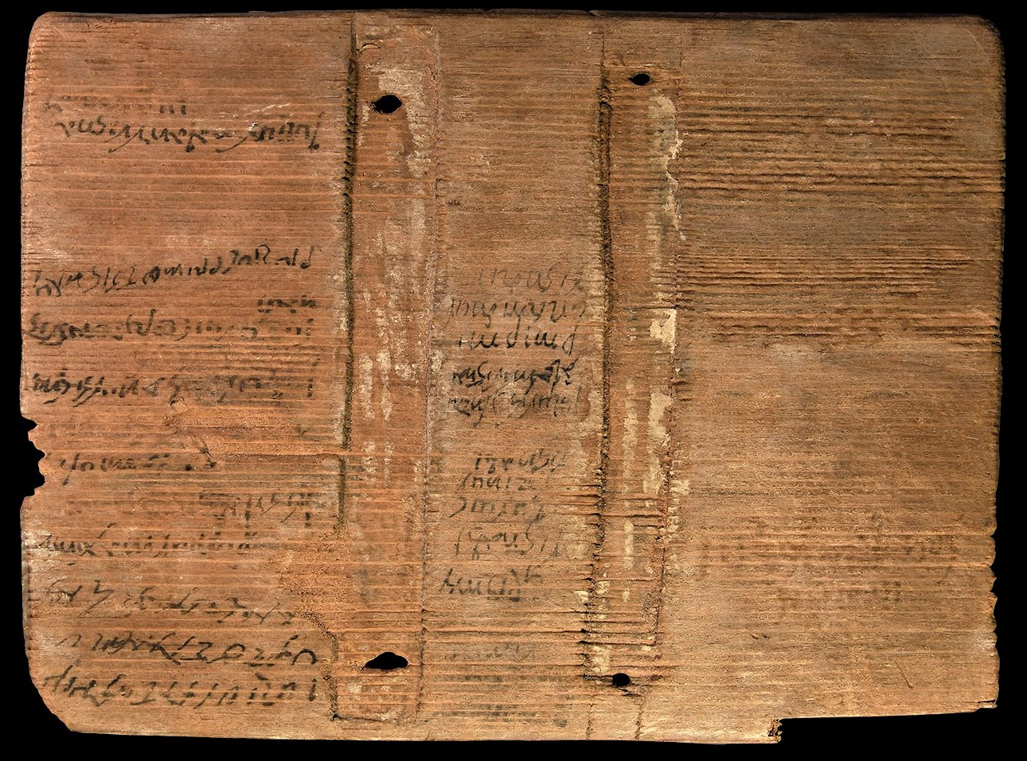
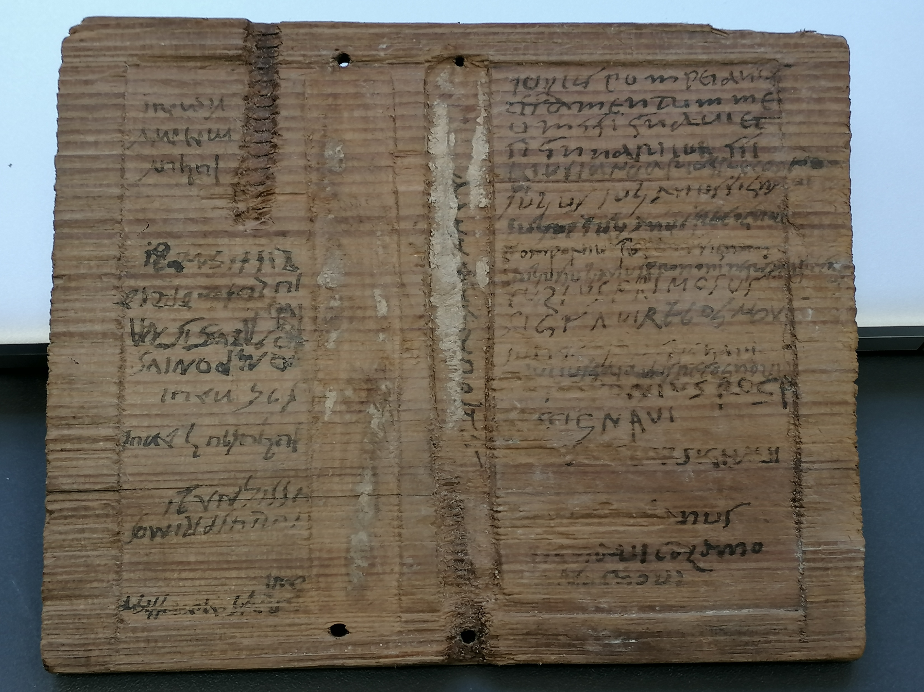
Witnesses, their seals and signatures

Slide 26
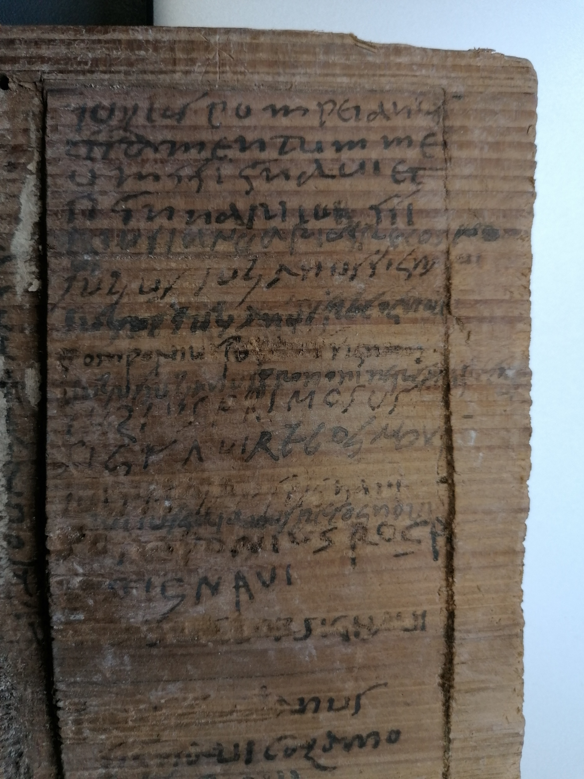
Witnesses, their seals and signatures
(1) Iulius Pompeianus
(2) testamentum me-
(3) um ssignavi et
(4) signari iussi
(5) I[u]lius Ianuarius recognovi
(6) Iulius Iulianus signavi
(7) Iulius Iulianus recognob[i]
(8) Pomponius Rogatus signavi
(9) Iulius Iulianus pro nom(i)ne Rogati recog(novi)
(10) Iulius Primosus
(11) signavi recognovi
(12) Iulius F[ca. 3-4]S signavi
(13) Iulius Gaianus recognovi
(14) [Po]mponius Roga-
(15) [tu]s signavi
(16) [---]S[---]+ signavi
(17) [---]+ANUS
(18) signavi COLAMO
(19) [r]ecognovi

