Slide 1
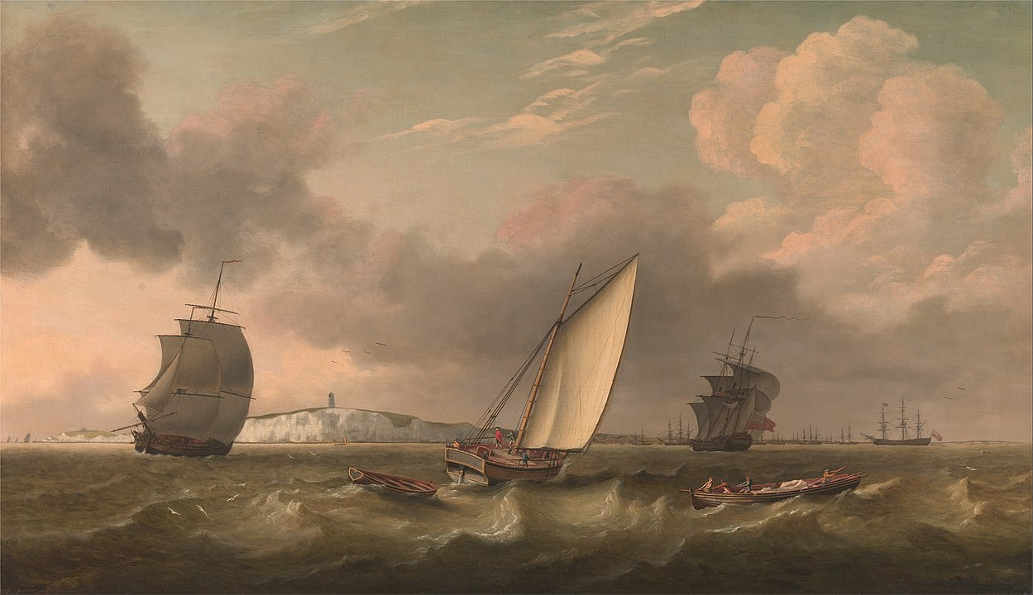
The sea as res omnium communes
in medieval and early modern legal literature
Bartosz Zalewski
Political-Legal Doctrines and Roman Law Departament

Slide 2

Glossa Ordinaria
D. 1, 8, 2, 1 [Marcianus libro tertio institutionum]: Et quidem naturali iure omnium communia sunt illa: aer, aqua profluens, et mare, et per hoc litora maris.
D. 1, 8, 4, pr. [Marcianus libro tertio institutionum]: Nemo igitur ad litus maris accedere prohibetur piscandi causa, dum tamen ullius et aedificiis et monumentis abstineatur, quia non sunt iuris gentium sicut et mare: idque et divus pius piscatoribus formianis et capenatis rescripsit.
D. 18, 1, 51 [Paulus libro 21 ad edictum]: Litora, quae fundo vendito coniuncta sunt, in modum non computantur, quia nullius sunt, sed iure gentium omnibus vacant: nec viae publicae aut loca religiosa vel sacra. Itaque ut proficiant venditori, caveri solet, ut viae, item litora et loca publica in modum cedant.
Gl. Naturali iure ad D. 1, 8, 2: Id est iure gentium, quod est instinctu naturae inductum… (Digestum vetus pandectarum iuris civilis tomus primus, ed. H. de la Porte, Lugduni 1560 )
Additio: Pro declaratione huius glo. dic. quod mare est commune quo ad usum; sed proprietas est nullius…
The status of the sea and coasts is determined primarily by ius gentium, not ius naturale.
Bartosz Zalewski, PhD
Political-Legal Doctrines
and Roman Law Departament

Slide 3

Placentinus and Azo – Bartolus de Saxoferrato
Placentinus, Summa Institutionum, Moguntiae 1535: Communia dicuntur flumina et maria, omnium animantium, ratione quorundam usuum, id est bibendi et abluendi, eadem sunt etiam publica, ratione aliorum usuum, id est tantum hominum ut navigandi et piscandi.
Azo Portius, Summa aurea, Lugduni 1557 (reprint: Frankfurt ab Main 1968), in secundum librum Institutionum § 7: Ad hoc respondet Placentin. quod omnia communia sunt publica, et converso; sed ratione quorundam usuum, quae sunt publica, non sunt communia, et converso; ut ecce: aer, mare, et littora maris, flumina etiam omnia, et eorundem ripae communes sunt omnium animalium: quia omnia animalia rationabilia, et irrationabilia his vesecuntur, et utundur abluendo, bibendo et in eis commorando, et similia, quae natura exigit faciendo. Eadem etiam ista omnia possunt dici publica, ratione quorundam usuum, qui solis hominibus competunt, puta piscandi, navigandi et retia siccandi, et involucra reponendi. Portus tamen ait Placent. esse publicos, non communes.
Sea is not only common, but also public thing.
Bartolus de Saxoferrato, Super Institutionibus Iuris Civilis Commentaria, Lugduni 1559: Item communia sunt maiores communitatis, quam publica…
Bartosz Zalewski, PhD
Political-Legal Doctrines
and Roman Law Departament

Slide 4
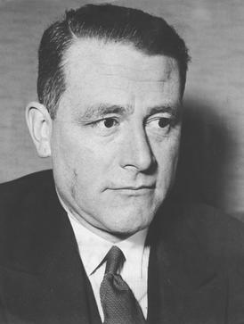
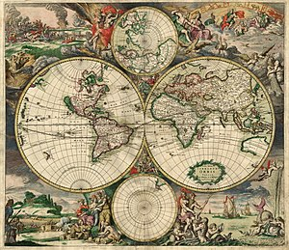
A new stage - the great geographical discoveries
Carl Schmitt noted that the lawyers of the time: “continued to abide by traditional conceptual models of Roman law. […] So attempts were made to understand the new phenomenon juridically by using traditional formulas…” (Nomos of the Earth in the International Law of the Jus Publicum Europaeum, trans. G.L. Ulmen, New York 2006, p. 175).
Bartosz Zalewski, PhD
Political-Legal Doctrines
and Roman Law Departament

Slide 5
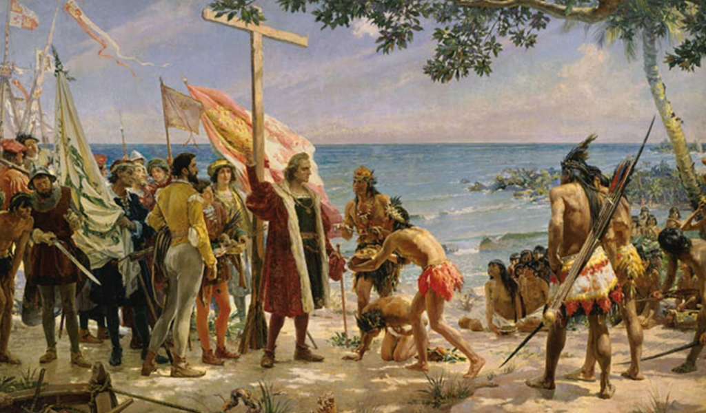
Francisco de Vitoria
Francisco de Vitoria, De Indis, [in:] Relectiones Theologicae, Matriti 1765: Quia quae in nullis bonis sunt, jure gentio sunt occupantis. Instit. de Rerum divis. §. Ferae bestiae. Ergo si aurum in agro, vel margaritae in mari, aut aliud quodcumque in fluminibus non est appropriatum, jure gentium erit occupantis, sicut et pisces in mari. Et quidem multa videntur procedere ex jure gentium, quod quia derivatur sufficienter ex jure naturali, manifestam vim habet ad dandum jus, et obligandum. Et dato quod non semper derivetur ex jure naturali, satis videtur esse consensus majoris partis totius orbis, maxime pro bono communi omnium. Si enim post prima tempora creati orbis, aut reparati post diluvium, major pars hominum constituerit, ut legati ubique essent inviolabiles, ut mare esset commune, ut bello capti essent servi, et hoc ita expediret, ut hospites non exigeruntur: certe hoc haberet vim, etiam aliis repugnantibus.
Bartosz Zalewski, PhD
Political-Legal Doctrines
and Roman Law Departament

Slide 6
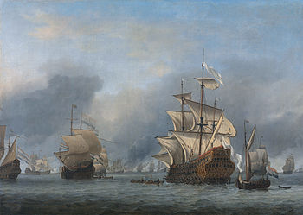

Alberico Gentili
Alberico Gentili, Hispanicae advocationis, Hanoviae 1613, lib. 1, cap. VIII: At ego, quod olim scripsi in libris bellicis, territorium et de terris dici, et de aquis. ‘Et dicunt Doctores, quod domini Veneti, et Genuenses, et alii habentes portum, dicuntur habere iurisdictionem et imperium in toto mari sibi propinquo per centum miliaria, vel etiam ultra, si non propinquant alteri provinciae. […]’. Et sic quidem Bartolus de centum illis miliariis, licet dicatur, quod mare est commune.
iurisdictio = imperium $≠$dominium = proprietas
Bartosz Zalewski, PhD
Political-Legal Doctrines
and Roman Law Departament

Slide 7
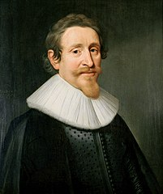
Hugo Grotius
Hugo Grotius, Mare Liberum sive de iure quod Batavis competit de indicana commercia disertatio, Lugduni 1609: Et eisdem de causis commune est omnium Maris Elementum, infinitum sic, ita, ut possideri non queat, et omnium usibus accomodatum: sive navigationem, sive et piscaturam.
Hugo Grotius, De iure belli ac pacis, ed. W. Whewell, vol. I, Cambridge 1853 [lib. II, cap. III § XIII]: Ut autem solum imperium in maris partem sine alia proprietate occupetur, facilius potuit procedere: neque arbitror ius illud gentium, de quo diximus, obstare.
Ibidem: Videtur autem imperium in maris portionem eadem ratione acquiri, qua imperia alia, id est, ut supra diximus, ratione personarum et ratione territorii. Ratione personarum, ut si classis, qui maritimus est exercitus, aliquo in loco maris se habeat: ratione territorii, quatenus ex terra cogi possunt, qui in proxima maris parte versantur, nec minus quam si in ipsa terra reprerirentur.
Empire [imperium]
over seas
ratione territorii
ratione personarum
Bartosz Zalewski, PhD
Political-Legal Doctrines
and Roman Law Departament

Slide 8
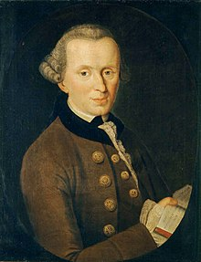
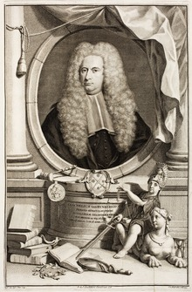
Cornelius van Bynkershoek and Immanuel Kant
Quare omnino videtur rectius, eo potestatem terrae extendi, quousque tormenta exploduntur, eatenus quippe cum imperare, tum possidere videmur
Cornelius van Bynkershoek, De dominio maris dissertatio, [in:] idem, Opera minora, ed. J. van der Linden, Lugduni 1730.
So far as I have the mechanical capability from my own Site, as the place I occupy, to secure my Soil from the attack of others—and, therefore, as far as Cannon can carry from the shore—all is included in my possession, and the sea is thus far closed (mare clausum). But as there is no Site for Occupation upon the wide sea itself, possible possession cannot be extended so far, and the open sea is free (mare liberum).
- I. Kant, The Philosophy of Law: An Exposition of the Fundamental Principles of Jurisprudence as the Science of Right, trans. W. Hastie
 | C. van Bynkershoek | I. Kant
Sea under state jurisdiction | Mare terrae proximum | Mare clausum
Free see | Mare exterum | Mare liberum
Bartosz Zalewski, PhD
Political-Legal Doctrines
and Roman Law Departament

Slide 9
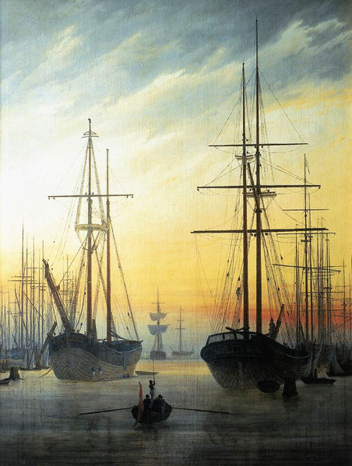
Conclusions
The use of Roman juridical structures in changed circumstances was the basis of the modern concept of the freedom of the seas.
They have been successfully applied to horizontal relations between states, understood as entities having specific rights and obligations.
In the vertical dimension, they were used to provide legal guarantees for individuals who could use the benefits of free navigation for the development of maritime commerce.
Reading the legal literature from the 16th and 17th centuries leads to the conclusion that public lordship (iurisdictio, imperium) was associated with ensuring safety and order, without constituting a basis for arbitrary violations of the freedom of navigation.
Technical development in the field of military ultimately allowed for the establishment of the limits of public-law lordship.
This is a consequence of adopting the Roman concept of possessio.
This fully shows the universalism of concepts and structures known from the history of Roman law, which are the theoretical foundation not only for contemporary private law systems, but also for public international law.
Bartosz Zalewski, PhD
Political-Legal Doctrines
and Roman Law Departament

Slide 10
Thank you for your attention!

