Slide 1
Traditions of Teaching (Roman) Private Law in Europe
University of Gdańsk
16 October 2023
Johannes Platschek

Slide 2
I.
Teaching Roman Law
as Timeless Private Law
Azo of Bologna (ca 1150-1230)
Quaestiones Sabbatinae

Slide 3
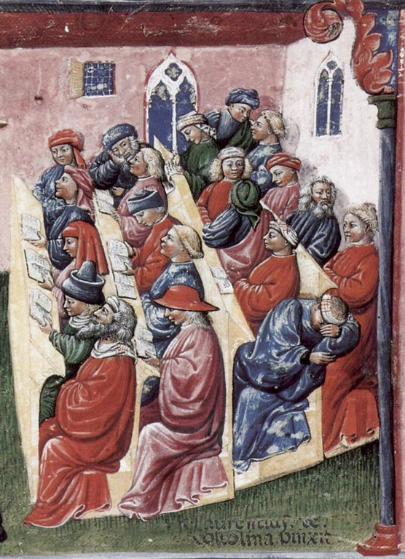

Slide 4
Bolognese School of Glossators:
Irnerius - Bulgarus - Joannes Bassianus - Azo - Accursius
Teaching the Justinian law books (529-534 AD):
■ Institutiones = textbook for first-year students
■ Digesta/Pandectae = collection from scientific legal literature (mostly 2nd/3rd century AD)
■ Codex Iustinianus = collection of imperial constitutions (2nd to 6th century AD)

Slide 5
Azo famous for
■ Summa Codicis; Summa Institutionum; later also: Summa Digestorum = synthetic and condensed representation of the Justinian law books
■ Lectura Codicis = transcript of teaching lessons on the Codex Justinianus
■ Brocardica aurea = “Golden Weaponry”, collection of legal maxims with supporting and contradicting passages from the Justinian law books

Slide 6
■ Quaestiones Sabbatinae –
“Saturday Disputes”
“Moot court” tradition: Small written case and passages from the Justinian law books
Students will plead, teacher will comment.
Since 1252: obligatory for all Bolognese doctores of the ius civile and the ius canonicum.
Transcripts of the Quaestiones of Azo have survived and were published by E. Landsberg in 1888.

Slide 7
Quaestio X
(Landsberg 71.20 - 75.17;
cf. Aulus Gellius, Noctes Atticae 5,10)

Slide 8
■ Plaintiff (P):
"Won litigation" to be interpreted broadly, not only as litigation with a third party.
If P started the first litigation only to let D win and the condition occur, this is not bad faith (dolus) but permissible pursuit of own interests, arguing with Digest 42,8,24: “Civil law is written for the vigilant.”
If D failed to formulate a narrower condition (“won litigation against a third party”), he has to blame himself and bear the loss.

Slide 9
■ Defendant (D):
It must not benefit P that D won against him in the first litigation.
It is unjust that P would have an action being founded in his wickedness (loosing intentionally the first litigation).
“Won litigation” in the sense of the condition has to be one lucrative for the buyer. It cannot be his own case against the seller. Hence the condition has not been occurred, the action not justified, arguing (from far away!) with
Digest 13,7,22,4 (?): Recourse claims of a pledgor only in case of lucrative pledge sale.

Slide 10
■ Solution/Azo:
The narrower interpretation
according to meaning and purpose
is more likely,
arguing with Digest 50,17,114:
“In obscure cases one must examine
what is more likely or more common.”

Slide 11
Justinian law books as a treasure trove
for – timeless – legal arguments.
Studying law is learning
to find the argument
within the (more or less) memorized
text masses.
Rhetorical/topical impact.

Slide 12
II.
Teaching Roman Law after the Codification of Private Law
since then:
Roman law as a propaedeutic exercise?
“Legal laboratory” working with
a set of rules, destilled from ancient sources?

Slide 13
“From the perspective of dogmatic history, the contemporary objects of Roman law are often irrelevant to the ratio: many sources deal with the law of slavery, for example. In very few cases, however, the ratio of a decision changes if ‘slave’ is replaced by ‘used car’, for example.”
Ch. Baldus, AcP 210 (2010) 22

Slide 14
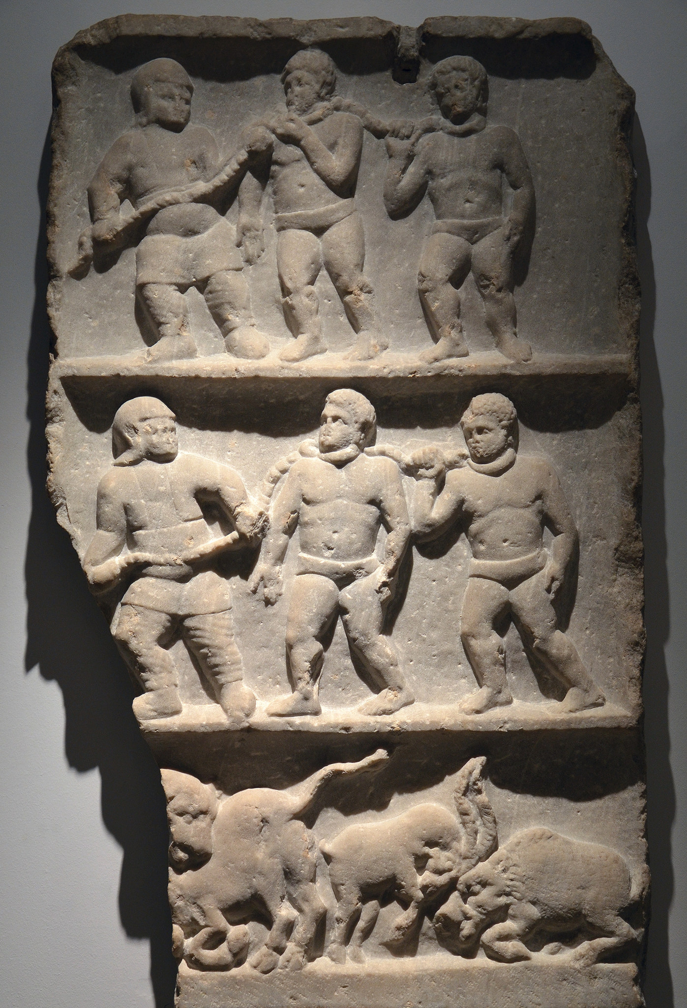

Slide 15
III.
Teaching Roman Law as a Historical Legal System
■ ancient social, economic and mentally impacts
■ procedural view
■ open discussions (ius controversum)
■ purpose: critical view on modern concepts, categories, principles

Slide 16
German Civil Code
(Bürgerliches Gesetzbuch)
§ 162. Preventing or bringing about the occurrence of a condition.
If the occurrence of the condition is
prevented in bad faith by the party to whose disadvantage it would be, the condition is considered as if it had occurred.
→ Debtor owes because of ficticious occurrence of the condition.

Slide 17
Digest 35,1,24 pr. (Iul. 55 dig.; mid IInd AD) = 50,17,161 (Ulp. 77 ed.; early IIIrd AD)
Debtor owes because of ficticious occurence of the condition.
Different cases.
Solution by fiction not shared by all
in every case!

Slide 18
■ Fiction necessary (and widely shared), if creditor can enforce his right in natura
(e.g. his freedom/manumission: ancient impact).
D. 40,7,3,16 (Ulp. 27 Sab.):
conditioned manumission by testament

Slide 19
■ Fiction not necessary
(and not widely shared: ius controversum),
if creditor can anyway enforce only compensation in money
(condemnatio pecuniaria: procedural view).
D. 18,1,50 pr. (Ulp. 11 ed.):
conditioned sale
compensation by actio praescriptis verbis
[not the sale action; that means: Labeo does not work with the fiction]."

Slide 20
■ In modern law there is the principle of enforceable performance in natura, compensation in money is secondary.
Therefore, fiction is always necessary
(critical view on modern principles).

